Slide 1
Shared Parking Tool User Guide
Python
February 2025

Slide 2
SECTION 1:
INSTALLATION & BACKGROUND SOFTWARE

Slide 3

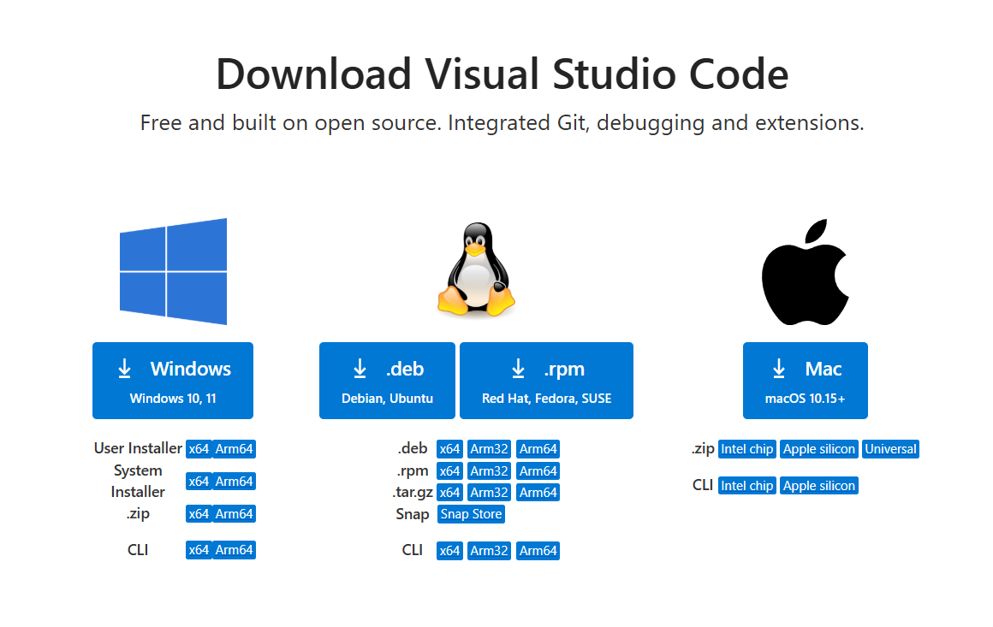
BACKGROUND SOFTWARE
Necessary software to run the tool:
Conda via Anaconda or Miniconda
Python Editor (e.g., VS Code)- optional
Software installation:
Download the software installer
Double-click the installer (.exe or .msi file)
https://code.visualstudio.com/download

Slide 4
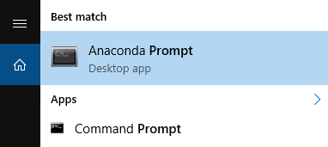
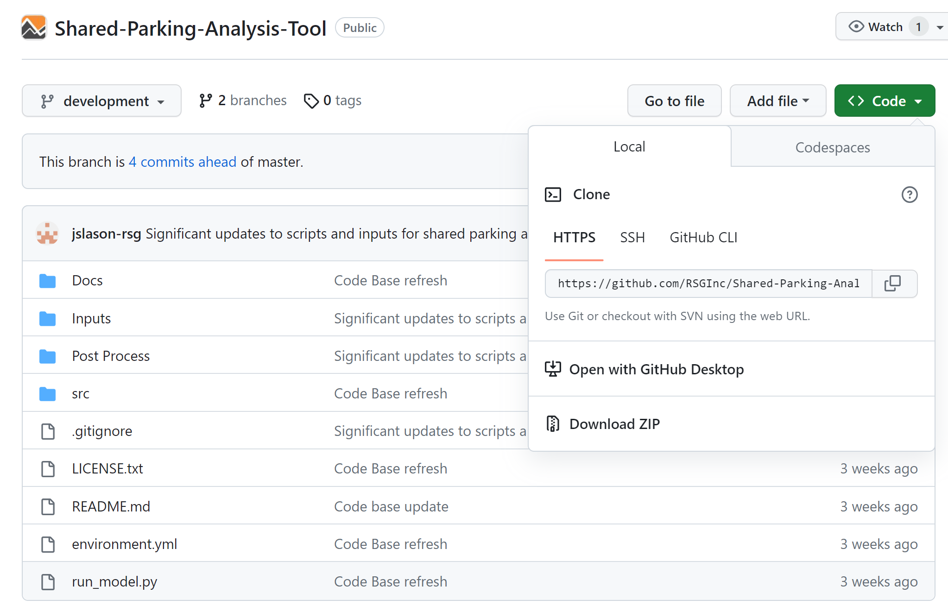
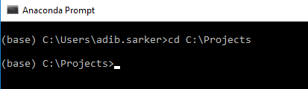
Download/Clone Repositroy
Download the SPA Code:
Clone the repository:
Or
Download Zip the repository in root C drive or local Documents location
Open the command prompt (cmd)/windows PowerShell/anaconda prompt
Change the directory to the desired location
Copy the repository url and clone the repository to the folder using following command
Download Zip
Copy

Slide 5
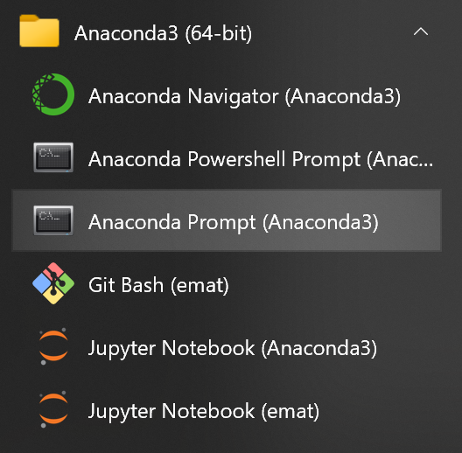
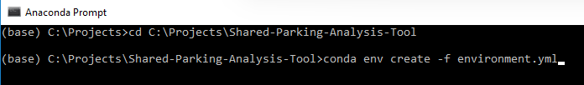
INSTALLING THE TOOL
Use Anaconda prompt to install the SPA Tool:
Open an Anaconda Prompt:
Change the directory to the repository location
Install the Shared Parking Environment by running the .yml file:

Slide 6
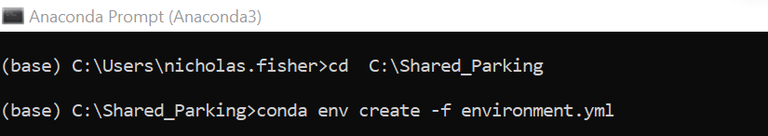
INSTALLING THE TOOL
Use Anaconda prompt to install the SPA Tool:
In the context of Python, an environment is a collection of packages and their dependencies that are used for a specific purpose, such as scientific computing or data analysis.
Separate environments are used for different projects, each with its own set of packages and dependencies, so that you can have different versions of packages installed for different projects without them conflicting with each other.
This can be especially useful when working on projects that have different package requirements or when you want to test your code against different versions of packages. By using separate environments, you can avoid dependency conflicts and ensure that your code will run consistently in different environments.
Open an Anaconda Prompt:
(Start menu→ Andaconda Prompt)
Run the following to install the Conda Environment:
user.name

Slide 7
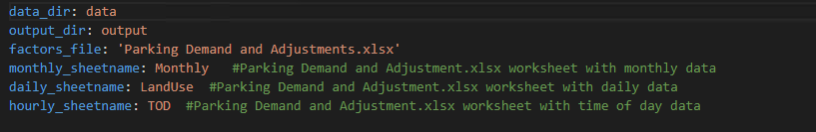
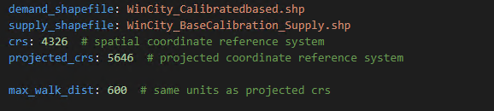
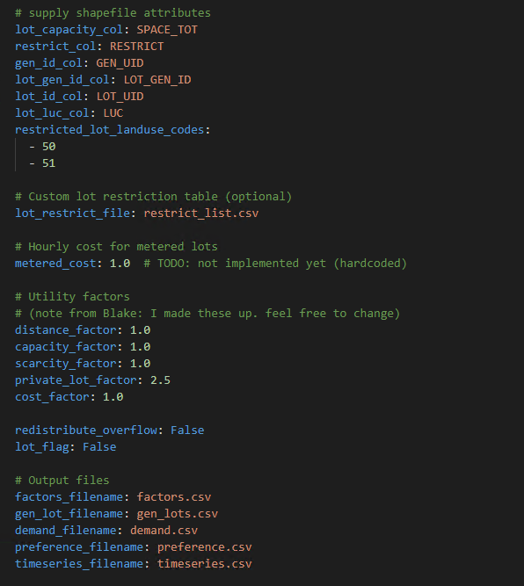
INPUTS TO THE CONFIGURATION FILE
Configuration.yaml
Open the file in a text editor
Most inputs are set to align with the ULI parking data in the “Parking Demand and Adjustments.xlsx” file.
Specify the names of the shapefile for the scenario
Specify the maximum allowed walking distance in the utility and parking equation
The column names in the shapefile
Restricted file name
Utility function costs which are used to calibrate the parking model
Output files from the python script. Don’t change.

Slide 8
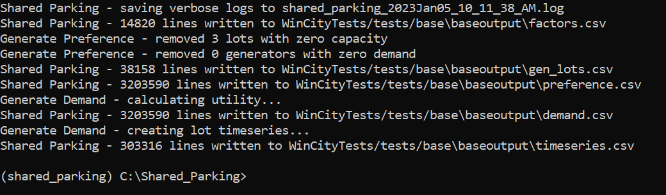
RUNNING THE TOOL
Line points to location of model script and the location of the configuration script.
Note: watch the direction of the “/”
Use the Anaconda prompt to activate the SPA Tool:
Activate the SPA Tool
Run the tool using “cnfiguration.yaml” example configuration:
The following output should be produced:

Slide 9

Thank you
NOTE
Jonathan Slason
DIRECTOR
Jonathan.slason@rsginc.com +1 802 698 3196

